Slide 1
Employee Data Analysis using Excel
STUDENT NAME: S.Swetha
REGISTER NO :312216615
DEPARTMENT:COMMERCE B.GENRAL
COLLEGE : R.B.Gothi Jain college for women

Slide 2
PROJECT TITLE
Employee Performance Analysis using Excel

Slide 3


AGENDA
Problem Statement
Project Overview
End Users
Our Solution and Proposition
Dataset Description
Modelling Approach
Results and Discussion
Conclusion
3/21/2024 Annual Review

Slide 4

PROBLEM STATEMENT
Analyzing employee performance using exel invovels several
Step to collect ,organize ,and evalute data effectively. Here
a step -by-step guide to help you with this process:
Difine key performance indicators (KPIs)
Enter data
Collect data
Set up your exel spreedsheet
Calculate performance scores
Conditional format
Use pivot table
create chart
Analyze the data
Generate report

Slide 5

PROJECT OVERVIEW
Objective:
To develop a comprehensive performance analysis system using Microsoft Excel that allows for the effective evaluation of employee performance based on predefined Key Performance Indicators (KPIs). This system aims to identify top performers, track performance trends, and provide actionable insights to support decision-making and improvement strategies.
.

Slide 6

WHO ARE THE END USERS?
The end users of an empoyee performance analyse
to tool typically include :
1. Hr professionals
2. managers/supervisor
3. empoyees
4. department heads
5. senior leadership
6. it teams

Slide 7

OUR SOLUTION AND ITS VALUE PROPOSITION
conditional formatting – to high light to
the missig value
filtering – for removing missing value
pivot table –summary
graph –data visualize

Slide 8
Dataset Description
employee= edunet dash board
26 features
Emp id-num
Name-text
Emp department
High light the missing value thorugh conditional format
Performance level
Gender- male female
Employee rating -num

Slide 9

THE "WOW" IN OUR SOLUTION
performance level = IF (Z8>=5,”VERY HIGH “
Z8>=4,”HIGH”,Z8>=3,”MED”,TRUE,”LOW”)
3/21/2024 Annual Review
9

Slide 10
MODELLING
To visualize employee performance data using a bar chart in
exel , follow these steps after setting up your data and creating a employee performance :
1. collection of data :
collection of data using edunet dash board
2. select data:
select and highlight data like employe id , name , gender , department ,
performance score .
3. filtering missing value:
filtering missing value is the use conditional format to highlight the
the blank value and filter it
10

Slide 11
MODELLING
4. Entering formula :
entering formula for the Z8 value to compute the very high
,high , mid, true , low
the formula is = IF (Z8>=5,”VERY HIGH “
Z8>=4,”HIGH”,Z8>=3,”MED”,TRUE,”LOW
5. pivot table:
using pivot table for showing the result through bar chart
6. bar chart :
bar chart is used for this data is 3D clustered chart

Slide 12
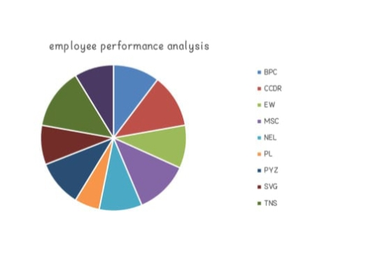
RESULTS
12

Slide 13
conclusion
Utilizing Excel for analyzing employee performance through PivotTables and bar charts provides a robust method for gaining insights into data. PivotTables enable dynamic data summarization, allowing you to organize and filter performance metrics by different dimensions such as employee names, departments, or roles. This facilitates detailed analysis and helps in identifying trends and patterns.

